Slide 1

Analysis of apps on Google play store
BATCH - 19
Akash Yadav – PES2201800415
Sanjith S Jadhav – PES2201800318

Slide 2
Objective :- Following Analysis will be the part of project
Categorize apps based on their popularity.
To conclude which kind of apps have the highest revenue.
Categorize the number of downloads in each genre of apps.
To find, if there is a relation between the number of app reviews and their ratings.

Slide 3
Literature Survey 1: A Longitudinal Study of App Permission Usage across the Google Play Store
Cite: J. H. Saltzer and M. D. Schroeder. The protection of information in computer systems. Proceedings of the IEEE, 63(9):1278–1308, 1975 N. Viennot, E. Garcia, and J. Nieh. A Measurement Study of Google Play. In The 2014 ACM International Conference on Measurement and Modeling of
Computer Systems, SIGMETRICS ’14, pages 221–233, New York, NY, USA, 2014. ACM
Reference: https://pdfs.semanticscholar.org/2ae8/2b0593124d236ea9f5202d48760ce69c644e.pdf
Abstract: Although there are over 1,600,000 third-party Android apps in the Google Play Store ans very little is known about how their individual permissions requirements have evolved over time. This work focuses exclusively on dangerous permissions, i.e., those permissions that guard access to sensitive user data. The permissions required by an app usually relate to the provision of the app’s functionality, but some apps are intentionally over-privileged to facilitate greater access to a user’s personal data.
Method: By taking snapshots of the Google Play Store over a one year period, we characterize changes in the number and type of dangerous permissions required by Android apps when they are updated, to gain a greater understanding of the evolution of permission usage in the Android app ecosystem. We built our own crawler that retrieved full app data (including permission usage) from the Google Play Store, by leveraging the list of apps from theGPSC project. We developed a cloud-based crawler, with geographically distributed worker nodes fetching app data and returning it to a command and control server.
Perks: Since Android 6.0, users are no longer forced to accept (or reject) permissions in their entirety at install-time, and can now accept (or reject)
permissions individually at run-time. This offers added control, but many users continue to accept permission requests blindly due to conditioning or lack of understanding.
Faults: We found that very popular apps (those with in excess of one million downloads) used more permissions than those with less downloads. We also discovered that apps were more likely to add new permissions than remove permissions, overall pointing to a potential erosion in privacy and security. Our data showed that more popular apps were more likely to add new permissions. This is worrying, because it means that a large segment of users in the Android ecosystem are potentially exposed to additional privacy/security risks simply as a result of using and updating popular apps.

Slide 4
Literature Survey 2 - Google play store app ranking prediction
Abstract - This paper study consists of different machine learning algorithms used to predict an app rating on Google play store utilizing real-time dataset of more than 10,000 play store apps. These results are obtained by collection cleansing training and testing data to evaluate each regression model furthermore alter data to get desired results. Finally after implementation it concluded that linear regression fine tree algorithm provides best app rating prediction results.
Methodology : To apply prediction model and analyse data these basic steps has been followed. 1. Data collection: Find a suitable dataset that fulfil the requirement to apply prediction models. 2. Pre-process data: To make data in correct format some filtration functions have been applied. 3. Explore data: Fix if there is any irrelevant value, sparsity, null, repetition and error. 4. Filter data: Remove extra columns that effects computation time and memory utilization. 5. Distribution data: Divide data into training and testing module. 6. Train data: Train the algorithm with training data until a correct model with minimum errors is obtained. 7. Data Evaluation: Compare the model with the testing data 8. Observe data: Analyse results.
Dataset used in this research work is authentic android platform user data. It consists of more than ten thousand instances collected in 2018. As it says on dataset repository site, it is hypothetical data available for analyst, mobile developer and university researchers who perform algorithm to estimate mobile app performance
Conclusion : In this paper, Machine learning algorithms have been evaluates to predict app ranking on given dataset. The results show that, despite the wide variety of techniques and complex algorithms, which could be improved using a different dataset or adding app features in order to make more accurate predictions, one of the most simple techniques, Fine tree, have provided the best results in making predictions from play store historical data. That concluded that, it could be possible and not a hard task to implement tree algorithm on dataset to predict app ranking, in order to forecast the suitable rating against an app, helping to improve app positioning, manage trends in app store meeting the demand of the app stores optimization and making rating systems more accurate
Cite - Muhammad Suleman College of Computer Science and Information Systems- CCSIS Institute of Business Management , Ahsan Malik College of Computer Science and Information Systems- CCSIS Institute of Business Management.
References - https://www.researchgate.net/profile/Syed_Hassan92/publication/331889811

Slide 5
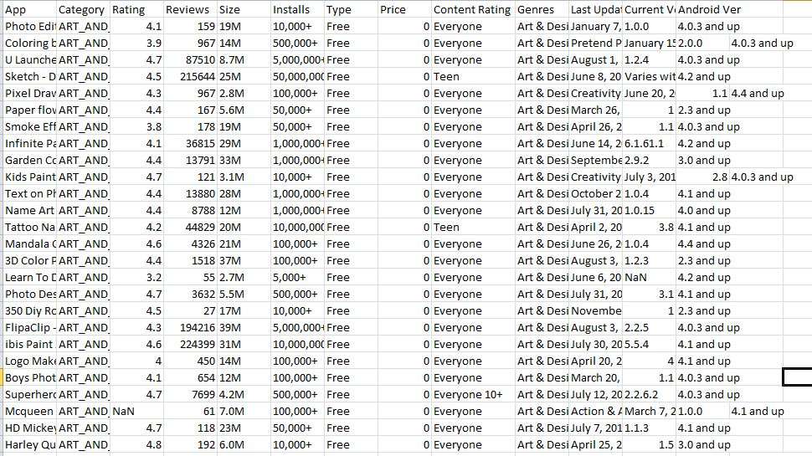
Data Set

Slide 6



Data Preprocessing:
Remove NaN values present in Rating column
Before
After

Slide 7
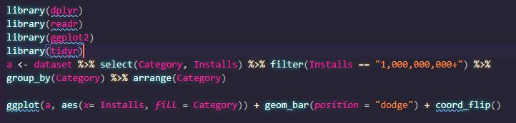
Visualization
Code:- Most Installed Apps Category

Slide 8
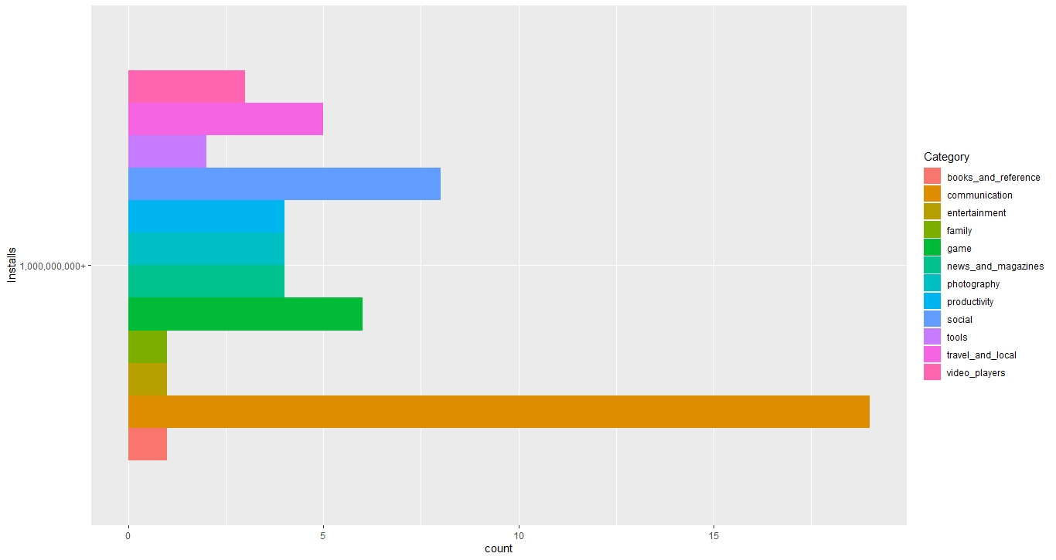
Conclusion:
communication, social and game apps are the most installed by over one billion people

Slide 9
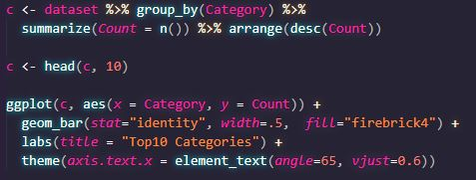
Code:- How many apps are included in each category ?

Slide 10
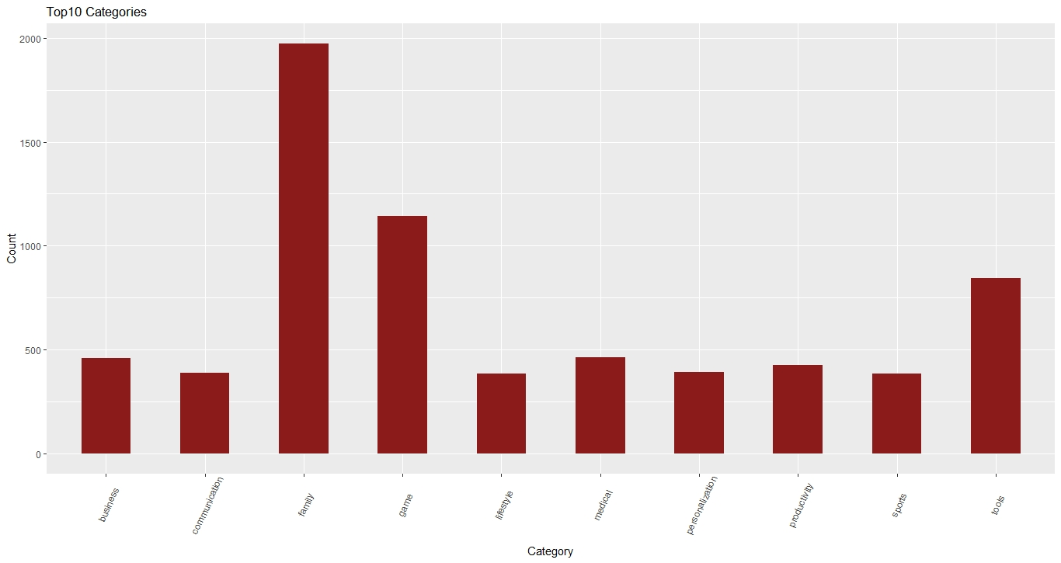
Conclusion:
Apps related to Family are the most frequent category followed by apps related to games

Slide 11
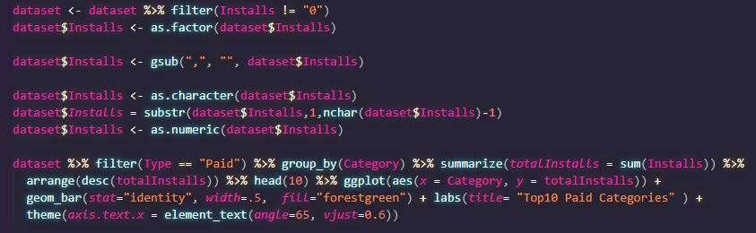
Code:- Top 10 Paid Apps ?

Slide 12
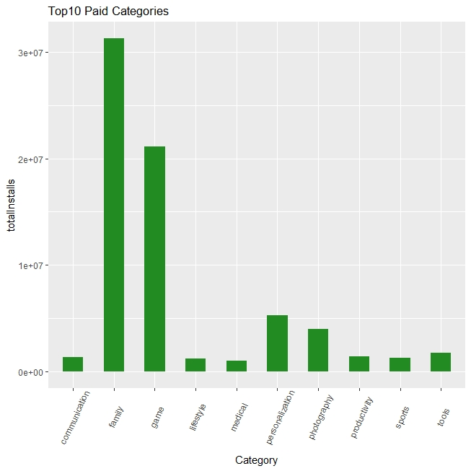
Conclusion: Family Apps has the highest income as it has the most number of installs

Slide 13

Code:- Average Rating across Apps

Slide 14
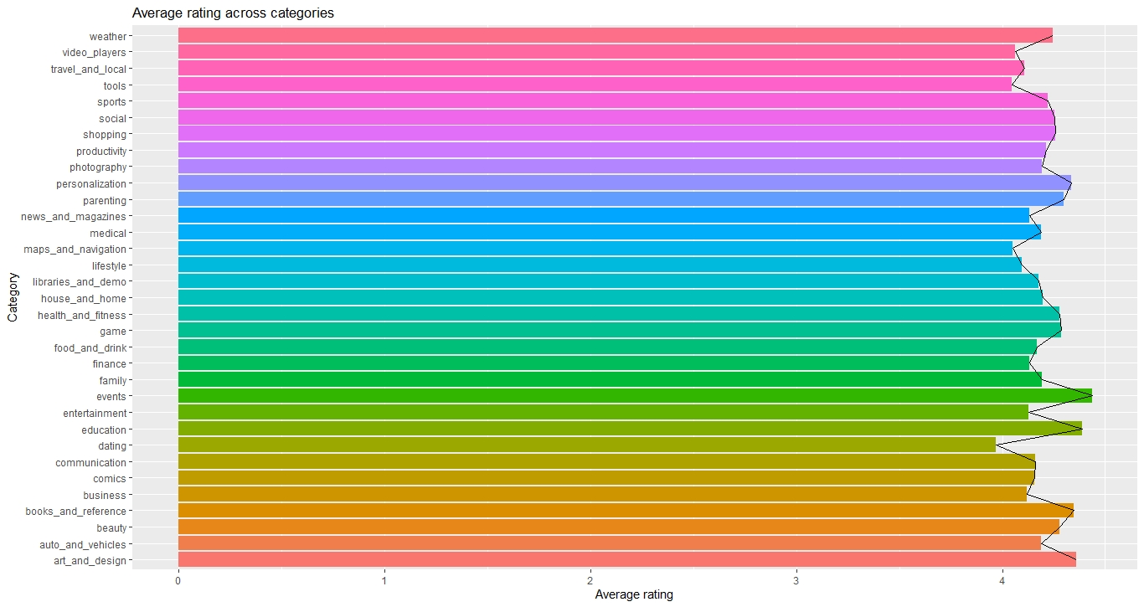
Conclusion: Categories generally have a similar mean rating, however, Events, personalization, education and art applications all tend to have a minutely higher rating.

Slide 15
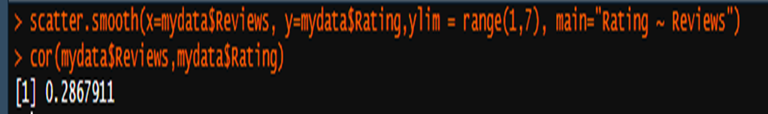
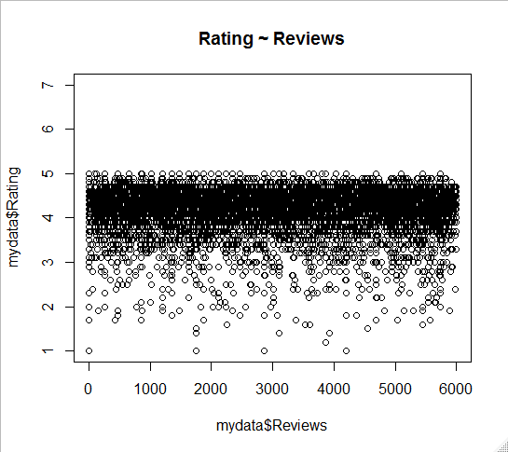
Regression and Prediction
Linear regression is one of the most commonly used predictive modelling techniques. The aim of linear regression is to find a mathematical equation for a continuous response variable Y as a function of one or more X variable(s). So that you can use this regression model to predict the Y when only the X is known.
Firstly we’ll plot a scatterplot and find the correlation between the rating and the review column of the dataset
We now get a broad idea of how the values are co-related.

Slide 16
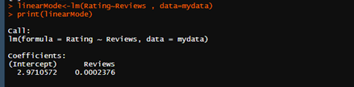
Building the regression model
By building the linear regression model, we have established the relationship between the predictor and response in the form of a mathematical formula.
The relationship can be given by ,
Rating = 2.971 + 0.0002376∗review

Slide 17
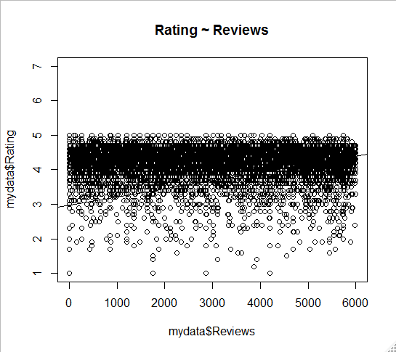
Regression Plot

Slide 18

Predicting the linear model
The preferred practice to predicting is to split your dataset into a 80:20 sample (training : test), then, build the model on the 80% sample and then use the model thus built to predict the dependent variable on test data(the left out 20% data).
Creating the training and test data.

Slide 19
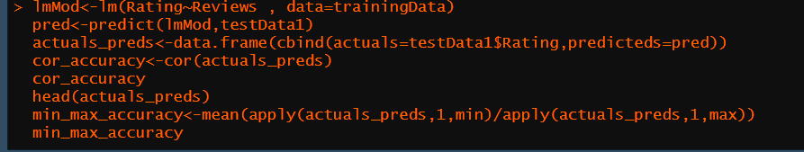
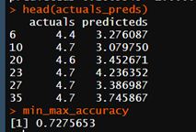
The code for predicting the accuraccy
The prediction accuracy turns out to be 72.75%

Slide 20
Hypothesis Testing
Null Hypothesis: The rating of the app does not depend on the number of reviews.
Alternate Hypothesis: The rating of the app depends on the number of reviews.

Slide 21

From our regression model , the p_value that we get is:
The p_value obtained here is less than 0.05 so we can conclude by rejecting the null hypothesis and thereby claiming that there is a relationship between the app ratings and the reviews.

Slide 22
THANK YOU

